Slide 1
Implementation of the project «Integrated Approach to Teacher Training» at the L.N. Gumilyov Eurasian National University
FINAL CONFERENCE PROGRAM OF PROJECT
«Integrated Approach to STEM Teacher Training»
Professor of the Department of Computer Science of the L.N. Gumilyov Eurasian National University,
project coordinator Meruyert Serik

Slide 3
L.N. Gumilyov Eurasian National University
Организован в 1996 году
В международном рейтинге QS World University Rankings университет занимает 328 место.
В рейтинге молодых университетов мира QS Top Universities Under 50 ЕНУ занимает 43 месте.
Количество преподавтелей – 1331:
докторов наук – 171
кандидатов наук – 489
докторов философии (PhD) - 213
Количество обучающихся – 19 588 (обучение проводится в очном формате):
в бакалавриате - 15958
в магистратуре - 2535
в докторантуре - 1095

Slide 4
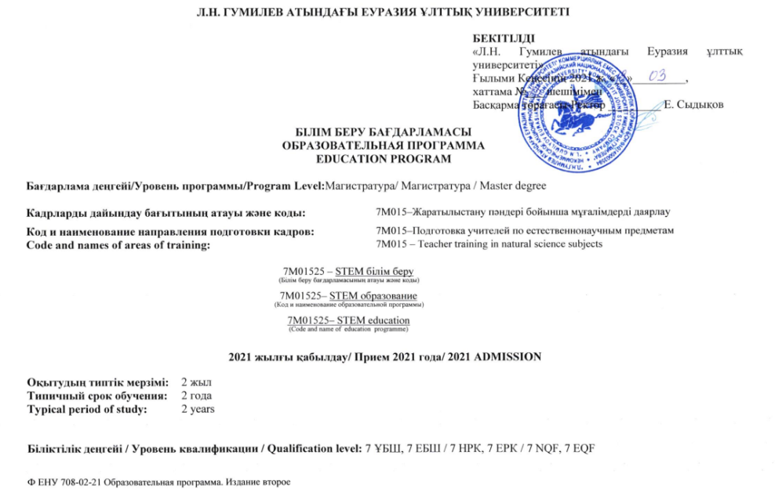
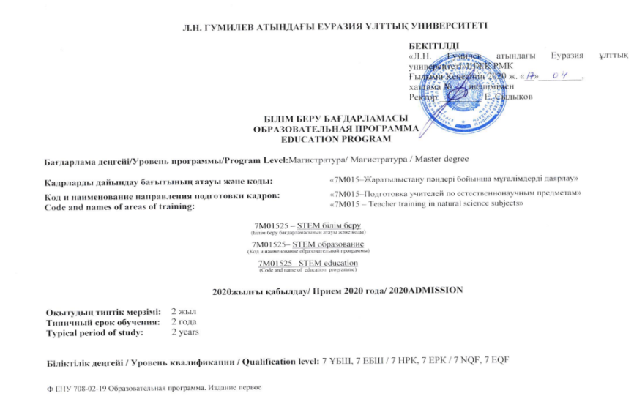
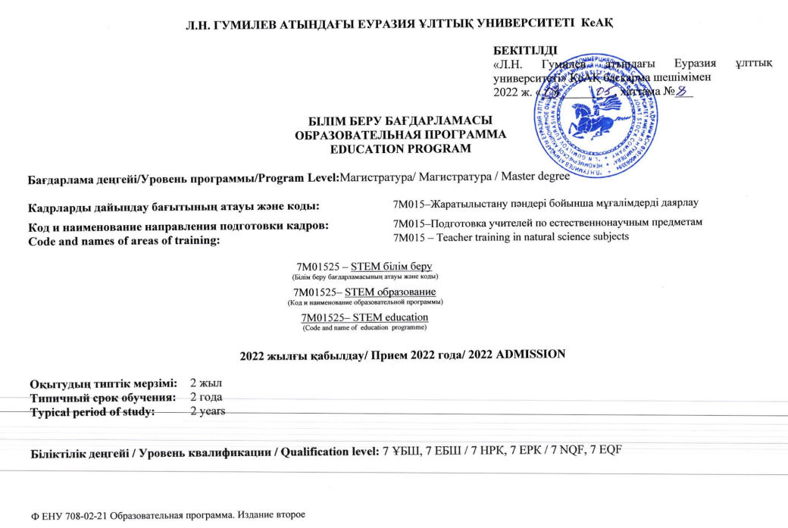
Developed & updated educational program «7М01525-STEM Education»:
2020-2021
2021-2022
2022-2023

Slide 5
Expert assessment of employers | Expert opinion of Ph.D., researcher of the National Academy of Sciences of the Ministry of Education and Science of the Republic of Kazakhstan Mukasheva M.U. Experimental conclusion of Doctor of Pedagogical Sciences, Professor of the Department of Computer Sciences of Al-Farabi KazNU, Almaty Kerimbayev N.N. Experimental conclusion of the employer-director of the State Institution "School-Lyceum No. 56" Baygaziev R.F. on the EP "7M01525- STEM Education" in the direction "7M015-Teacher Training in Natural Science Subjects". Expert opinion of Associate Professor of L.N. Gumilyov ENU Kazykhanova A.A.

Slide 6
State exam of graduates

Slide 7
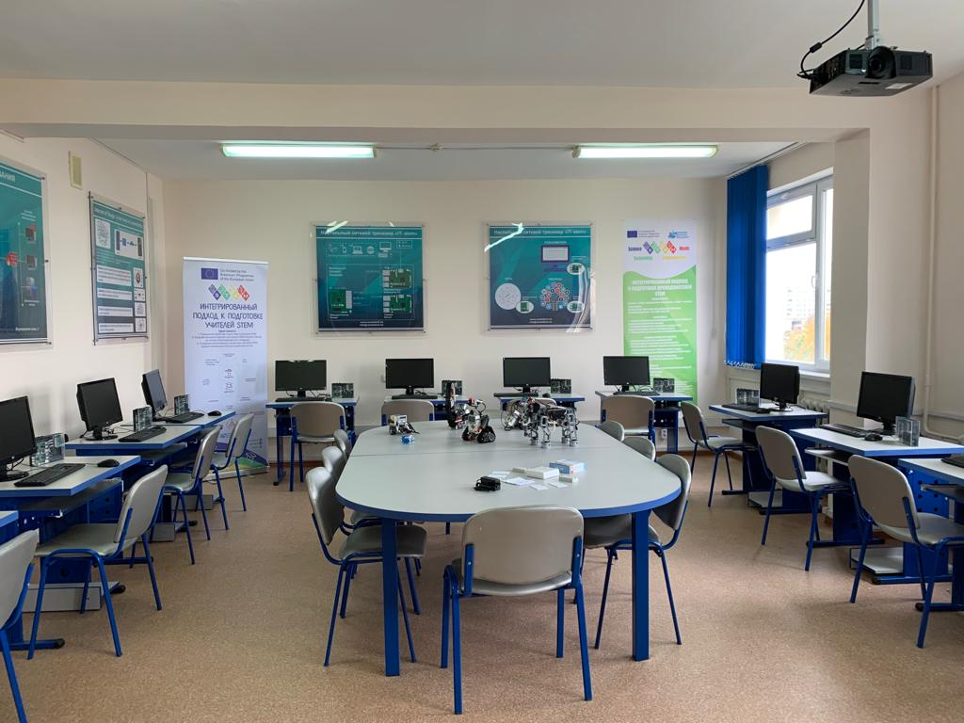
STEM-Center of Program “Integrated Approach to STEM Teacher Training”
The purpose of stem center is to increase the interest of students in engineering and technical specialties based on the comprehensive use of science, technology, natural sciences and mathematical sciences, to provide young people with early vocational guidance and to focus on the development of potential in the areas of high-tech and knowledge-intensive.

Slide 8
International Conference «Integrated Approach to STEM Teacher Training» (24.02.2021)

Slide 9
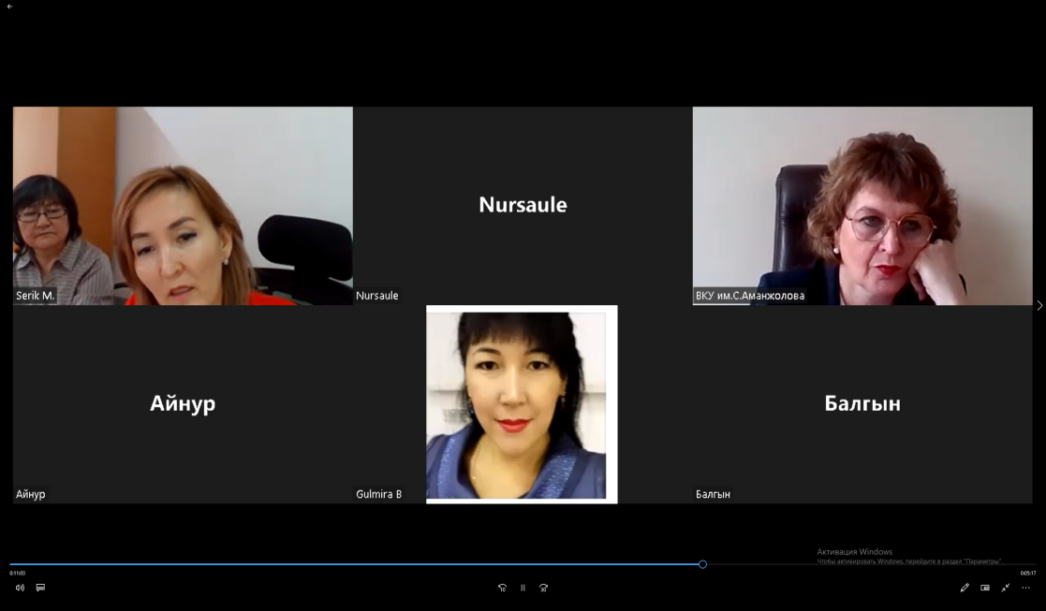
National seminar to raise awareness of the training of masters under the Erasmus + program (29.03.2022)
The ENU coordinator, Professor Serik M., acquainted the participants of the seminar with the ongoing career guidance work on STEM education.
The Department of Computer Science has a dissertation council, where doctoral students study and engage with STEM problems.
The coordinator, Vice-rector of the University, Rovnyakova I.V. spoke about the completed work on awareness of STEM education at the S. Amanzholov EKSU. At the end, the M.O. Auezov SKSU coordinator, associate professor, Omasheva G.Sh. made a speech.

Slide 10
Summer school on the basis L.N. Gumilyov Eurasian National University «STEM in Modern education: Trends and Strategies»
Registered participants | Offline participants | Schoolchildren participants | Speakers
119 | 47 | 8 | 24 (Lecture-24 hour, Practice-38 hour, Discussion-5 hour, Master class-5 hour )
Program of STEM Festival & Summer school

Slide 11
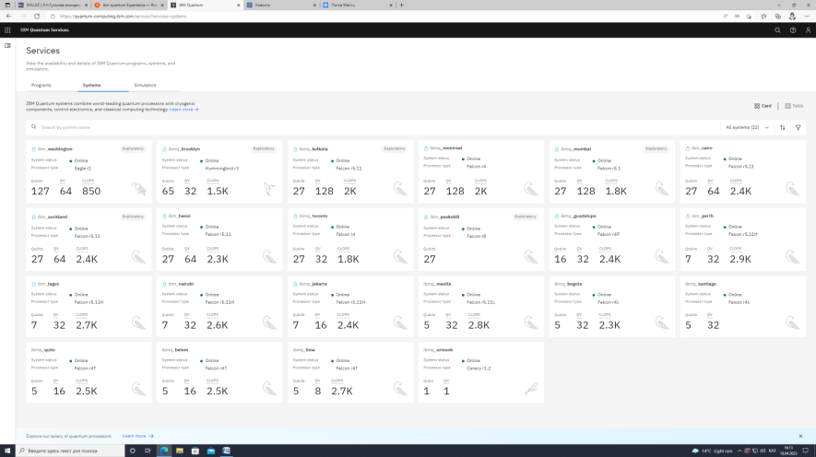
Summer school on the basis L.N. Gumilyov Eurasian National University «STEM in Modern education: Trends and Strategies»

Slide 12
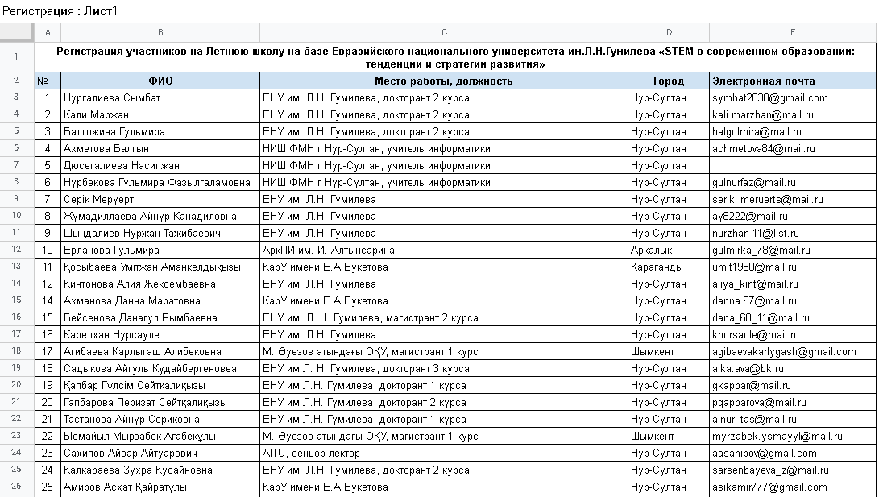
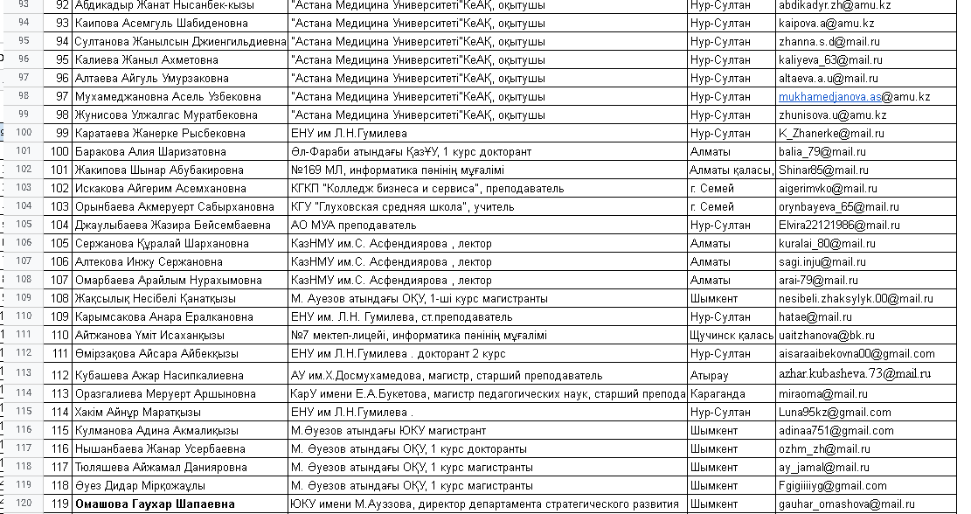
Registered participants-119
Link: https://docs.google.com/spreadsheets/d/1PNLkCf5Pw5mvninpmDQfRfWNJ2GLtNnDqiAxRH3qBr0/edit?usp=sharing

Slide 13
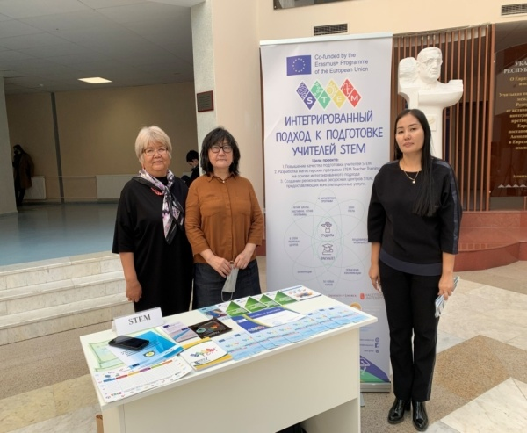
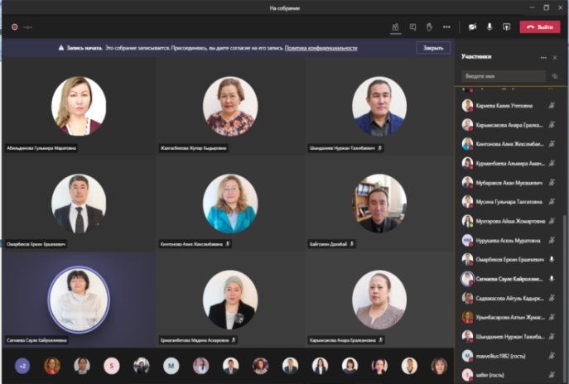
Regional training workshops in STEM days «STEM-training and methods of conducting practical exercises» (12.01.2021; 15.10.2021; 25.01.2022)

Slide 14
Interproject coaching
In connection with the Erasmus Days on 15.10.2021, an exhibition of projects within the framework of Increasing the Potential of Higher Education, as well as an information day on the credit mobility program of the Erasmus + program was held at L.N. Gumilyov ENU. The exhibition was attended by all interested persons, including coordinators for international cooperation, teaching staff and students of the faculty. The purpose of the exhibition: to acquaint the general public with the achievements and results of the projects; organization of practical sessions (trainings) for the dissemination of project results with the active involvement of participants; demonstration of the impact of projects at the individual, institutional and national levels. Members of the team of the project "Integrated approach to the training of STEM teachers" presented information on STEM education on the poster.
In On December 22, 2021, on the basis of Astana IT University in honor of the 30th anniversary of Independence of the Republic of Kazakhstan, the National Office of the Erasmus + Program in Kazakhstan together with the Department of Higher and Postgraduate Education of the Ministry of Education and Science of the Republic of Kazakhstan and the Delegation of the European Union in Kazakhstan with the support of the European Executive Agency for Education and Culture of the European Commission ( EACEA) held a poster session of the results of the Erasmus+ air defense projects in Kazakhstan. The event was held in a mixed format (30 participants offline, the rest online). Members of the National Team for the Reform of Higher Education of the Republic of Kazakhstan, members of project teams, representatives of L.N. GumilyovENU, including members of the project 598367-EPP-1-2018-1-SE-EPPKA2-CBHE-JP /STEM "Integrated Approach to STEM Teacher Training".

Slide 15
Awareness: Social networks, monograph, newspapers, conferences, career guidance

Slide 16
Coordination meetings (2022)
On October 5-8, a coordination meeting was held in Istanbul on the implementation and implementation of the project plan "Integrated approach to the training of STEM teachers". The meeting was attended by the project coordinator from Sweden, project experts from Turkey, Ireland and Finland, as well as members of partner universities from Kazakhstan: L.N. Gumilyov ENU, M. Auezov SKU and S. Amanzholov EKU.
As part of the Integrated Approach to STEM Teacher Training (STEM) project under the European Erasmus + program, from November 25-27, 2022, in Nevsehir (Turkey), an event called “STEM project training and STEM & Makers Fest/Expo STEM & Makers Fest/Expo".

